Slide 1
UNIT-II
Data Link Layer

Slide 2
Data Link Layer Design Issues
Services Provided to the Network Layer
Framing
Error Control
Flow Control

Slide 3
Functions of the Data Link Layer
Provide service interface to the network layer
Dealing with transmission errors
Regulating data flow

Slide 4
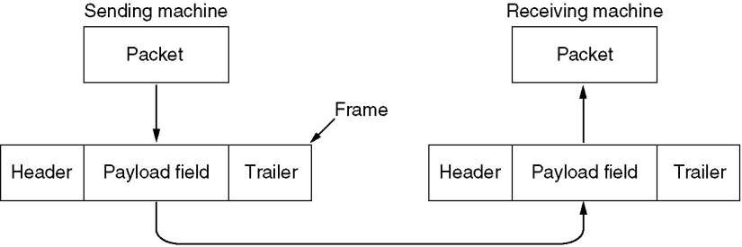
Functions of the Data Link Layer (2)
Relationship between packets and frames.

Slide 5
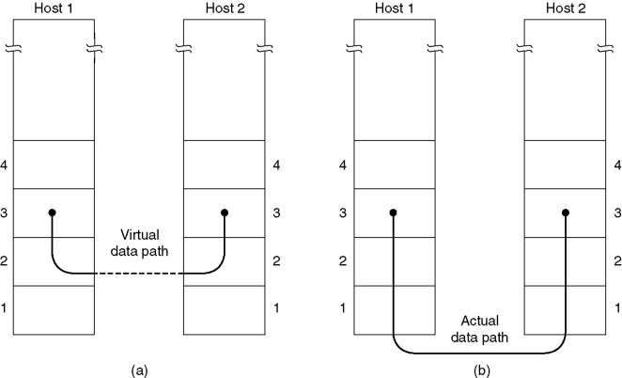
Services Provided to Network Layer
Virtual communication.
Actual communication.

Slide 6
Services Provided to Network Layer
Unacknowledged connectionless service.
Acknowledged connectionless service.
Acknowledged connection-oriented service

Slide 7
Services Provided to Network Layer
This class of service is appropriate when the error rate is very low so that recovery is left to higher layers. It is also appropriate for real-time traffic, such as voice.
The next
step up in terms of reliability is acknowledged
connectionless service.
When this service
is offered, connections used, but each
there frame
are still no logical
sent is individually
acknowledged.
In this way, the sender knows whether a frame has arrived correctly. If it has not arrived within a specified time interval, it can be sent again.

Slide 8
Three distinct phases of CO
connection is established
frames are actually transmitted
connection is released

Slide 9
Relation of frames and checksum
The usual approach is for the data link layer to break the bit stream up into discrete frames and compute the checksum for each frame.
When a frame arrives at the destination, the checksum is recomputed.
If the newly-computed checksum is different from the one contained in the frame, the data link layer knows that an error has occurred and takes steps to deal with it (e.g., discarding the bad frame and possibly also sending back an error report).

Slide 10
Framing
Frames are generally data unit of data link layer that is transmitted or transferred among various network points. It includes complete and full addressing, protocols that are essential, and information under control.
Methods of Framing:
Byte count or Character count.
Flag Bytes with Byte stuffing or character stuffing. 3.Flag bits with Bit stuffing.

Slide 11
Byte Count
This method is rarely used and is generally required to count total number of characters that are present in frame. This is be done by using field in header.
Character count method ensures data link layer at the receiver or destination about total number of characters that follow, and about where the frame ends.
There is disadvantage also of using this method i.e., if anyhow character count is disturbed or distorted by an error occurring during transmission, then destination or receiver might lose synchronization. The destination or receiver might also be not able to locate or identify beginning of next frame.

Slide 12
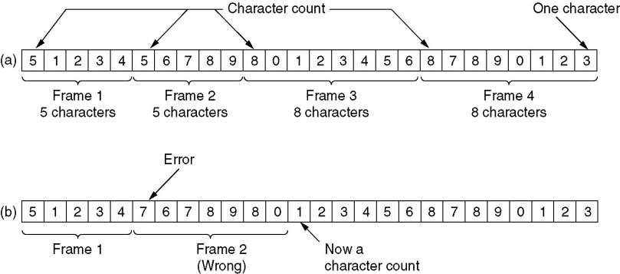
Byte Count
A character stream.
(a) Without errors. one error.
(b) With

Slide 13
Byte Stuffing
In byte stuffing, special byte that is basically known as ESC (Escape Character) that has predefined pattern is generally added to data section of the data stream or frame when there is message or character that has same pattern as that of flag byte.
But receiver removes this ESC and keeps data part that causes some problems or issues. In simple words, we can say that character stuffing is addition of 1 additional byte if there is presence of ESC or flag in text.
Point-to-Point Protocol (PPP) is a byte-oriented protocol.

Slide 14
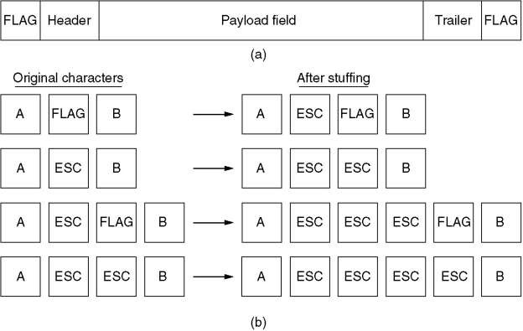
Byte Stuffing
A frame delimited by flag bytes.
Four examples of byte sequences before and after stuffing.

Slide 15
Bit Stuffing
In bit stuffing, extra bits are being added by network protocol designers to data streams.
It is developed based on HDLC(High-level Data Link Control) protocol.
It is generally insertion or addition of extra bits into transmission unit or message to be transmitted as simple way to provide and give signaling information and data to receiver and to avoid or ignore appearance of unintended or unnecessary control sequences.

Slide 16
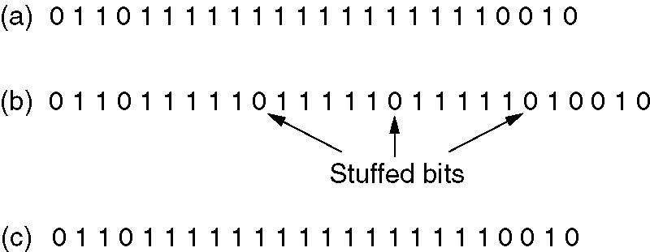
Bit Stuffing
Bit stuffing
The original data.
The data as they appear on the line.
The data as they are stored in receiver’s memory after destuffing.

Slide 17
Error Control
How to make sure all frames are eventually delivered to the
network layer at the destination and in the proper order?
The usual way to ensure reliable delivery is to provide the sender with some feedback about what is happening at the other end of the line.
If the sender receives a positive acknowledgement about a frame, it knows the frame has arrived safely. On the other hand, a negative acknowledgement means that something has gone wrong and the frame must be transmitted again.

Slide 18
Error Control
An additional complication comes from the possibility that hardware troubles may cause a frame to vanish completely (e.g., in a noise burst). In this case, the receiver will not react at all, since it has no reason to react.
This possibility is dealt with by introducing timers into the data link layer. When the sender transmits a frame, it generally also starts a timer.
The timer is set to expire after an interval long enough for the frame to reach the destination, be processed there, and have the acknowledgement propagate back to the sender.

Slide 19
Error Control
It is generally necessary to assign sequence numbers to outgoing frames, so that the receiver can distinguish retransmissions from originals.
The whole issue of managing the timers and sequence numbers so as to ensure that each frame is ultimately passed to the network layer at the destination exactly once, no more and no less, is an important part of the duties of the data link layer (and higher layers).

Slide 20
Flow Control
Another important design issue that occurs in the data link layer (and higher layers as well) is what to do with a sender that systematically wants to transmit frames faster than the receiver can accept them.
Two approaches are
commonly used. In the first
one,
back
feedback-based flow control, the receiver sends
information to the sender giving it permission to send more
data, or at least telling the sender how the receiver is doing.
In the second one, rate-based flow control, the protocol has a built-in mechanism that limits the rate at which senders may transmit data, without using feedback from the receiver.

Slide 21
Error Detection and Correction
Data can be corrupted during transmission.
For reliable communication, errors must be detected and corrected.

Slide 22
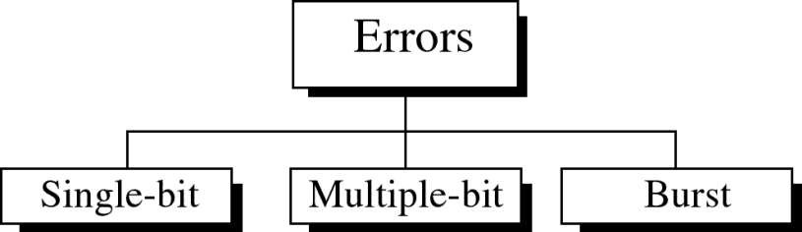
Types of errors

Slide 23
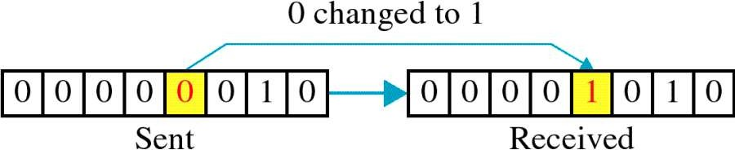
Single-bit error
Only one bit in the data unit changes.

Slide 24
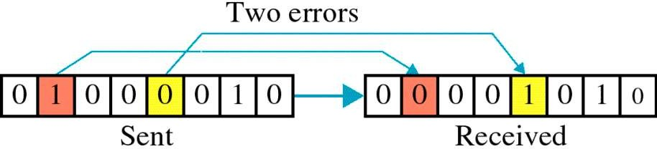
Multiple-bit error

Slide 25
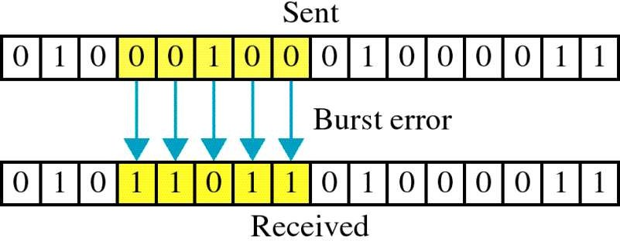
Burst error
Means two or more bits in the data unit have changed.
The length of the burst is measured from the first corrupted bit
to the last corrupted bit.
The number of bits affected depends on the data rate and duration of the
noise.
Example: if we are sending data at 1 Kbps, a noise of 1/100 sec can affect
10 bits.

Slide 26
Error Detecting Codes
Whenever a message is transmitted, it may get scrambled by noise or data may get corrupted. To avoid this, we use error- detecting codes which are additional data added to a given digital message to help us detect the errors.
Basic approach used for error detection is the use of redundancy bits, where additional bits are added to facilitate detection of errors.
Some popular techniques for error detection are:
Simple Parity check
Two-dimensional Parity check
Checksum
Cyclic redundancy check

Slide 27
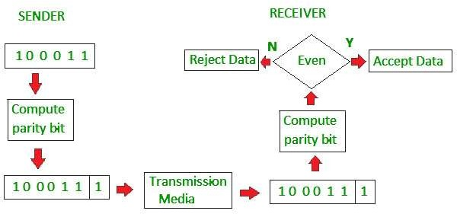
Simple Parity check
Blocks of data from the source are subjected to a check bit or parity bit generator form, where a parity of :
1.1 is added to the block if it contains odd number of 1’s, and
2.0 is added if it contains even number of 1’s
This scheme makes the total number of 1’s even, that is why
it is called even parity checking.

Slide 28
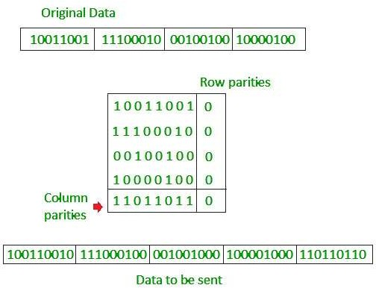
Two-dimensional Parity check
Parity check bits are calculated for each row, which is equivalent to a simple parity check bit. Parity check bits are also calculated for all columns, then both are sent along with the data. At the receiving end these are compared with the parity bits calculated on the received data.

Slide 29
Checksum
In checksum error detection scheme, the data is divided into k segments each of m bits.
In the
sender’s end the segments are added using 1’s
complement arithmetic to get the sum. The sum is complemented to get the checksum.
The checksum segment is sent along with the data segments.
At the receiver’s end, all received segments are added using 1’s complement arithmetic to get the sum. The sum is complemented.
If the result is zero, the received data is accepted; otherwise
discarded.

Slide 30
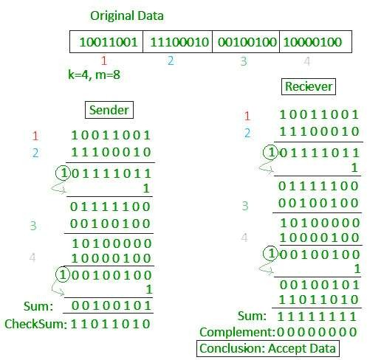
Checksum

Slide 31
AT SENDER:
1 0 0 0 1 0 0 1 Word 1
1 0 1 1 1 0 0 0 Word 2
-
1 0 1 0 0 0 0 0 1 Sum using one’s complement arithmetic
1 Remove carry and add it back
-
0 1 0 0 0 0 1 0 sum
1 0 1 1 1 1 0 1 checksum
The pattern sent is
<------- word1 word2 checksum
AT RECEIVER:
1 0 0 0 1 0 0 1 Word 1
1 0 1 1 1 0 0 0 Word 2
1 0 1 1 1 1 0 1 Checksum
-
1 1 1 1 1 1 1 1 0 Sum using one’s complement arithmetic
1 Remove carry and add it back
-
1 1 1 1 1 1 1 1 sum
0 0 0 0 0 0 0 0 complement
//means the pattern is OK

Slide 32
Cyclic redundancy check (CRC)
Unlike checksum scheme, which is based on addition, CRC is
based on binary division.
In CRC, a sequence of redundant bits, called cyclic redundancy check bits, are appended to the end of data unit so that the resulting data unit becomes exactly divisible by a second, predetermined binary number.
At the destination, the incoming data unit is divided by the same number. If at this step there is no remainder, the data unit is assumed to be correct and is therefore accepted.
A remainder indicates that the data unit has been damaged in transit and therefore must be rejected.

Slide 33
Polynomials
The CRC generator(the divisor) is most often represented not
as a string of 1s and 0s, but as an algebraic polynomial.
A polynomial selected should have following properties:
It should not be divisible by x : it guarantees that all the burst errors of a length equal to the degree of polynomial are detected.
It should be divisible by x+1 : it guarantees that all burst errors
affecting an odd number of bits are detected.

Slide 34
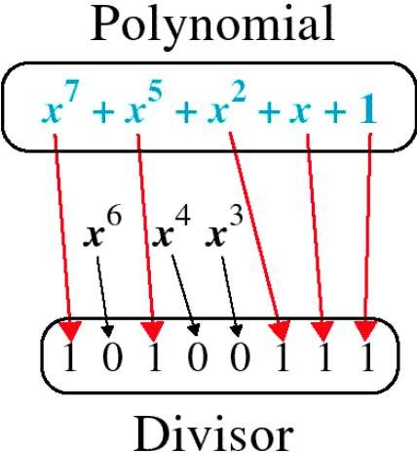
Polynomial and Divisor

Slide 35
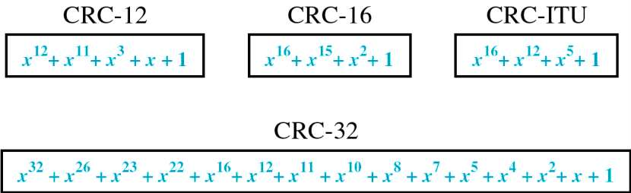
Standard Polynomials
The numbers 12, 16, and 32 refers to the size of CRC remainder. The CRC divisors are 13, 17, and 33 bits, respectively.

Slide 36
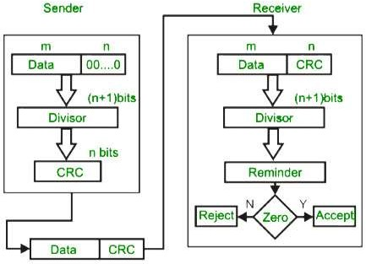
Cyclic redundancy check (CRC)

Slide 37
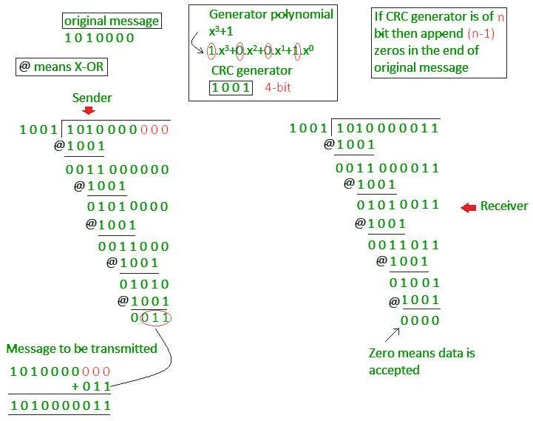
Cyclic redundancy check (CRC)

Slide 38
Performance:
CRC can detect all burst errors that affect an odd number of
bits.
CRC can detect all burst errors of length less than or equal to
the degree of polynomial.
CRC can detect with a very high probability – burst errors of length greater than the degree of the polynomial.

Slide 39
Error correction
Error-correcting codes are more sophisticated than error
detection codes, and require more redundancy bits.
The number of bits required to correct a burst error is so high that in most cases , it is inefficient to do so.
Therefore, most error-correction is limited to one- ,two- , or three bits.

Slide 40
Single-bit error correction:
First step in error correction is locating invalid bit position.
Suppose data is composed of 7 bit ASCII code. To locate one of
the 7 positions , 3 extra bits are sufficient.
But if the error occurs in these additional bits, so to cover all possibilities(7 bits of data+3 redundant bits), we need additional bits.

Slide 41
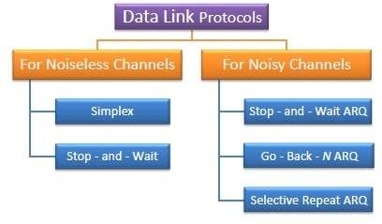
Data Link Layer Protocols

Slide 42
Elementary Data Link protocols
Elementary Data Link protocols are classified into three categories, as given below
Protocol 1 − Unrestricted simplex protocol-Utopia Protocol 2 − Simplex stop and wait protocol Protocol 3 − Simplex protocol for noisy channels.

Slide 43
Unrestricted Simplex Protocol
Data transmitting is carried out in one direction only.
The transmission (Tx) and receiving (Rx) are always ready and
the processing time can be ignored.
In this protocol, infinite buffer space is available, and no errors
are occurring that is no damage frames and no lost frames.

Slide 44
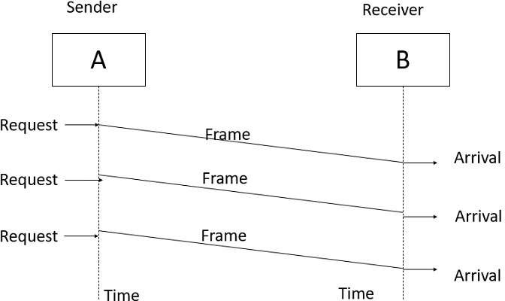
Unrestricted Simplex Protocol
The Unrestricted Simplex Protocol is diagrammatically represented as follows

Slide 45
Simplex Stop and Wait protocol
In this protocol we assume that data is transmitted in one
direction only.
No error occurs; the receiver can only process the received information at finite rate. These assumptions imply that the transmitter cannot send frames at rate faster than the receiver can process them.
The main problem here is how to prevent the sender from flooding the receiver.
The general solution for this problem is to have the receiver send some sort of feedback to sender, the process is as follows −

Slide 46
Simplex Stop and Wait protocol
Step1 − The receiver send the acknowledgement frame back to the sender telling the sender that the last received frame has been processed and passed to the host.
Step 2 − Permission to send the next frame is granted.
Step 3 − The sender after sending the sent frame has to wait for an acknowledge frame from the receiver before sending another frame.
This protocol is called Simplex Stop and wait protocol, the sender sends one frame and waits for feedback from the receiver. When the ACK arrives, the sender sends the next frame.

Slide 47
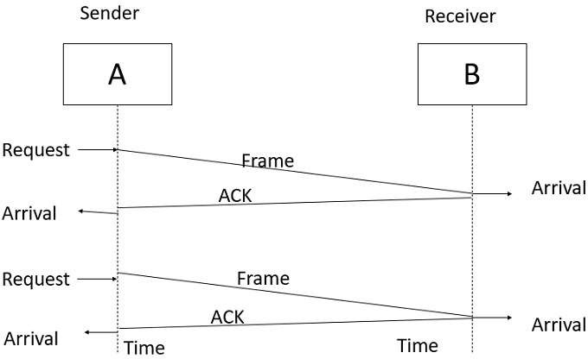
Simplex Stop and Wait protocol
The Simplex Stop and Wait Protocol is diagrammatically represented as follows

Slide 48
Simplex Protocol for Noisy Channel
Data transfer is only in one direction, consider separate sender and receiver, finite processing capacity and speed at the receiver, since it is a noisy channel, errors in data frames or acknowledgement frames are expected. Every frame has a unique sequence number.
After a frame has been transmitted, the timer is started for a finite time. Before the timer expires, if the acknowledgement is not received , the frame gets retransmitted, when the acknowledgement gets corrupted or sent data frames gets damaged, how long the sender should wait to transmit the next frame is infinite.

Slide 49
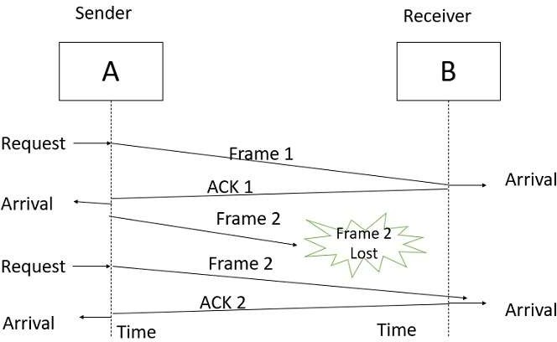
Simplex Protocol for Noisy Channel
The Simplex Protocol for Noisy Channel is diagrammatically represented as follows

Slide 50
Sliding Window Protocols
The sliding window is a technique for sending multiple frames at a time.
It controls the data packets between the two devices where reliable and gradual delivery of data frames is needed. It is also used in TCP.
In this technique, each frame has sent from the sequence number.
The sequence numbers are used to find the missing data in the receiver end.
The purpose of the sliding window technique is to avoid
duplicate data, so it uses the sequence number.

Slide 51
Sliding Window Protocols
Types of sliding window protocols
One-bit sliding window protocol
Go-Back-N ARQ
Selective Repeat ARQ

Slide 52
One-bit sliding window protocol
One bit sliding window protocol is used for delivery of data frames.
Sender has sending window.
Receiver has receiving window.
Sending and receiving windows act as buffer storage.
Here size of windows size is 1.
One bit sliding window protocol uses Stop and Wait protocol.
Sender transmit a frame with sequence number.
Than sender wait for acknowledgment from the receiver.
Receiver send back an acknowledgement with sequence number.
If sequence number of acknowledgement matches with sequence
number of frame.
Sender transmit the next frame.
Else sender re-transmit the previous frame.
Its bidirectional protocol.

Slide 53
Go-Back-N ARQ
Go-Back-N ARQ protocol is also known as Go-Back-N Automatic
Repeat Request.
It is a data link layer protocol that uses a sliding window method.
In this, if any frame is corrupted or lost, all subsequent frames have
to be sent again.
The size of the sender window is N in this protocol. For example, Go- Back-8, the size of the sender window, will be 8. The receiver window size is always 1.
If the receiver receives a corrupted frame, it cancels it. The receiver does not accept a corrupted frame. When the timer expires, the sender sends the correct frame again.

Slide 54
Go-Back-N ARQ
The example of the Go-Back-N ARQ protocol is shown below.
Suppose there is a sender and a receiver. There are 11 frames to be sent, and the frames are numbered as 0,1,2,3,4,5,6,7,8,9,10. The sequence number of the frames is decided by the size of the window N. For better understanding, we have taken the running numbers.
Let's take the sender's window size to be 4, which means the sender can send 4 frames before expecting any acknowledgement from the first frame, which is 0.

Slide 55
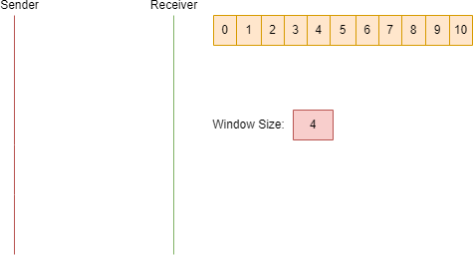
Go-Back-N ARQ

Slide 56
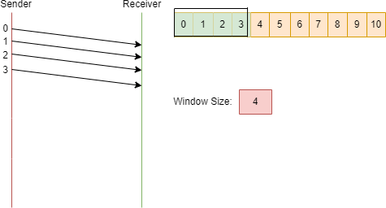
Go-Back-N ARQ
The sender sends the first frame, which is 0. Now, only frame 0 will be there in the current window. The sender will send the next frames in the buffer (1, 2, 3) because the sender can send 4 frames at a time without expecting any acknowledgement from the receiver.

Slide 57
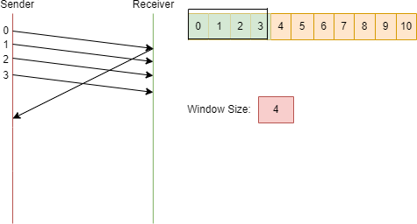
Go-Back-N ARQ
The sender is expected to receive an acknowledgement from the receiver. Let's assume the sender received an acknowledgement for frame 0 from the receiver.

Slide 58
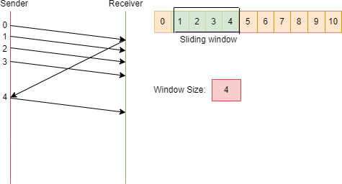
Go-Back-N ARQ
Frame 0 is sent and acknowledged. The current window size is 3; the sender will send the next frame from the buffer, which is 4, and the window slides.

Slide 59
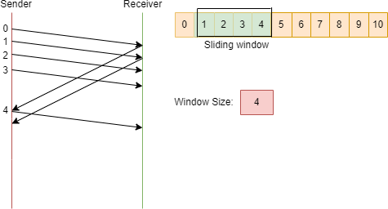
Go-Back-N ARQ
Now, the
current window size is 4. So, the receiver
acknowledges frame number 1.

Slide 60
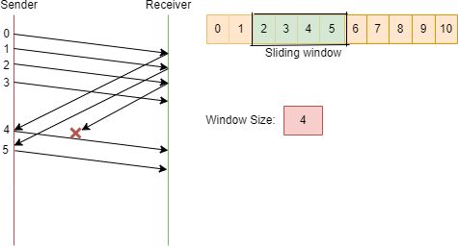
Go-Back-N ARQ
The window slides and the sender will send the next frame in the buffer, which is 5, and the window slides. Let's assume that the sender is not acknowledging frame number 2 because either the frame is lost or the acknowledgement is lost.

Slide 61
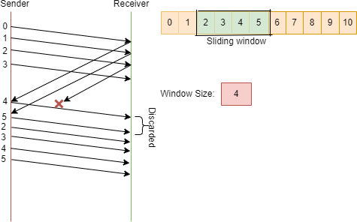
Go-Back-N ARQ
Now, the sender will wait for a certain period of time. If the acknowledgement of frame 2 is not received, it will go back to 2, and whatever the frames are there in the current window, it will retransmit all of them (2, 3, 4, 5).

Slide 62
Selective Repeat ARQ
•
Selective repeat protocol, also known as Selective Repeat
Automatic Repeat Request (ARQ), is a data link layer protocol that
uses the sliding window technique for reliable data frame delivery.
Only erroneous or lost frames are retransmitted in this case, while
good frames are received and buffered.
Working of Selective Repeat ARQ
In Selective Repeat ARQ, only the erroneous or lost frames are retransmitted, while correct frames are received and buffered.
While keeping track of sequence numbers, the receiver buffers the frames in memory and sends NACK (negative acknowledgement) for only the missing or damaged frame.
The sender will send/retransmit the packet for which NACK
(negative acknowledgement) is received.

Slide 63
Selective Repeat ARQ
An example to understand the protocol:
Suppose there is a sender and a receiver. There are 11 frames to be sent, and the frames are numbered as 0,1,2,3,4,5,6,7,8,9,10. The sequence number of the frames is decided by the size of the window N. For better understanding, we have taken the running numbers.
Let's take the sender's window size to be 4, which means the sender can send 4 frames before expecting any acknowledgement from the first frame, which is 0.

Slide 64
Selective Repeat ARQ

Slide 65
Selective Repeat ARQ
The sender sends the first frame, which is 0. Now, only frame 0 will be there in the current window. The sender will send the next frames in the buffer (1, 2, 3) because the sender can send 4 frames without expecting any acknowledgement from the receiver.

Slide 66
Selective Repeat ARQ
The sender is expected to receive an acknowledgement from the receiver. Let's assume the sender received an acknowledgement for frame 0 from the receiver.

Slide 67
Selective Repeat ARQ
Frame 0 is sent and acknowledged. The current window size is 3; the sender will send the next frame from the buffer, which is 4, and the window slides.

Slide 68
Selective Repeat ARQ
Now, the current window size is 4. So, the receiver
acknowledges frame number 1.

Slide 69
Selective Repeat ARQ
The window slides and the sender will send the next frame in the buffer, which is 5, and the window slides. Let's assume that the sender is not acknowledging frame number 2 because either the frame is lost or the acknowledgement is lost.

Slide 70
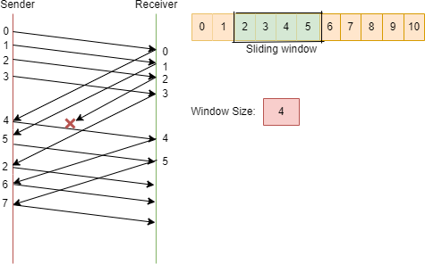
Selective Repeat ARQ
In this case, the sender will not send frames 4 and 5 again, and it knows that frame 2 is missing because the receiver would have sent a negative acknowledgement (NACK) for frame 2. So, the sender will retransmit frame 2 alone and as usual other frames are transmitted.

Slide 71
The Medium Access Control Sub layer

Slide 72
Channel Allocation Problem
In a broadcast network, the single broadcast channel is to be allocated to one transmitting user at a time.
When multiple users use a shared network and want to access the same network. Then channel allocation problem in computer networks occurs.
So, to allocate the same channel between multiple users, techniques are used, which are called channel allocation techniques in computer networks.

Slide 73
Channel Allocation Techniques
For the efficient use of frequencies, time-slots and bandwidth channel allocation techniques are used. There are three types of channel allocation techniques that you can use to resolve channel allocation problem in computer networks as follows:
1.Static channel allocation 2.Dynamic channel allocation 3.Hybrid channel allocation.

Slide 74
Channel Allocation Techniques
Static Channel Allocation
The traditional way of allocating a single channel between multiple
users is called static channel allocation.
Static channel allocation is also called fixed channel allocation. Such as a telephone channel among many users is a real-life example of static channel allocation.
Dynamic Channel Allocation
The technique in which channels are not permanently allocated to the users is called dynamic channel allocation. In this technique, no fixed frequency or fixed time slot is allotted to the user.
The allocation depends upon the traffic. If the traffic increases, more channels are allocated, otherwise fewer channels are allocated to the users.
This technique optimizes bandwidth usage and provides fast data
transmission.

Slide 75
Channel Allocation Techniques
Hybrid Channel Allocation
The mixture of fixed channel allocation and dynamic channel
allocation is called hybrid channel allocation.
The total channels are divided into two sets, fixed and
dynamic sets.
First, a fixed set of channels is used when the user makes a call. If all fixed sets are busy, then dynamic sets are used. When there is heavy traffic in a network, then hybrid channel allocation is used.

Slide 76
CSMA Protocols
CSMA is a network access method used on shared network
topologies such as Ethernet to control access to the network.
Devices attached to the network cable listen (carrier sense) before transmitting. If the channel is in use, devices wait before transmitting.
MA (Multiple Access) indicates that many devices can connect to and share the same network.
All devices have equal access to use the network when it is
clear.

Slide 77
CSMA Protocols
CSMA protocol was developed to overcome the problem found in ALOHA i.e. to minimize the chances of collision, so as to improve the performance.
CSMA protocol is based on the principle of ‘carrier sense’. The station senses the carrier or channel before transmitting a frame. It means the station checks the state of channel, whether it is idle or busy.
The chances of collision still exist because of propagation delay. The frame transmitted by one station takes some time to reach other stations. In the meantime, other stations may sense the channel to be idle and transmit their frames. This results in the collision.

Slide 78
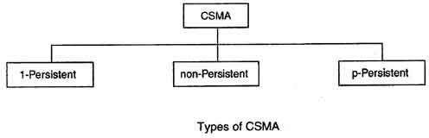
CSMA Protocols

Slide 79
I-persistent CSMA
In this method, station that wants to transmit data continuously
senses the channel to check whether the channel is idle or busy.
If the channel is busy, the station waits until it becomes idle.
When the station detects an idle-channel, it immediately transmits
the frame with probability 1. Hence it is called I-persistent CSMA.
This method has the highest chance of collision because two or more stations may find channel to be idle at the same time and transmit their frames.
When the collision occurs, the stations wait a random amount of
time and start all over again.

Slide 80
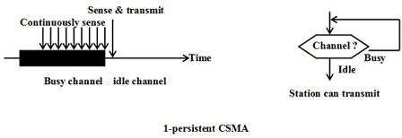
I-persistent CSMA
Drawback of I-persistent:
The propagation delay time greatly affects this protocol.
Let us suppose, just after the station I begins its transmission, station 2 also became ready to send its data and senses the channel. If the station I signal has not yet reached station 2, station 2 will sense the channel to be idle and will begin its transmission. This will result in collision.
Even if propagation delay time is zero, collision will still occur. If two stations became ready in the middle of third station’s transmission, both stations will wait until the transmission of first station ends and then both will begin their transmission exactly simultaneously. This will also result in collision.

Slide 81
Non-persistent CSMA
In this scheme, if a station wants to transmit a frame and it finds that the channel is busy (some other station is transmitting) then it will wait for fixed interval of time.
After this time, it again checks the status of the channel and if the
channel is free it will transmit.
A station that has a frame to send senses the channel.
If the channel is idle, it sends immediately.
If the channel is busy, it waits a random amount of time and then senses
the channel again.
In non-persistent CSMA the station does not continuously sense the channel for the purpose of capturing it when it detects the end of previous transmission.

Slide 82
Non-persistent CSMA
Advantage of non-persistent
It reduces the chance of collision because the stations wait a random amount of time.
It is unlikely that two or more stations will wait for same amount of time and will retransmit at the same time.
Disadvantage of non-persistent
It reduces the efficiency of network because the channel remains idle when there may be stations with frames to send.
This is due to the fact that the stations wait a random amount of time after the collision.

Slide 83
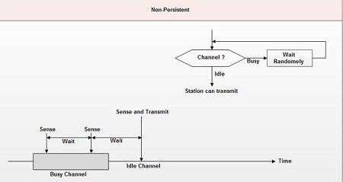
Non-persistent CSMA

Slide 84
p-persistent CSMA
This method is used when channel has time slots such that the time slot duration is equal to or greater than the maximum propagation delay time.
Whenever a station becomes ready to send, it senses the
channel.
If channel is busy, station waits until next slot.
If channel is idle, it transmits with a probability p.
With the probability q=l-p, the station then waits for the beginning of the next time slot.
If the next slot is also idle, it either transmits or waits again with probabilities p and q.

Slide 85
p-persistent CSMA
This process is repeated till either frame has been transmitted
or another station has begun transmitting.
In case of the transmission by another station, the station acts as though a collision has occurred and it waits a random amount of time and starts again.
Advantage of p-persistent
It reduces the chance of collision and improves the efficiency of the network.

Slide 86
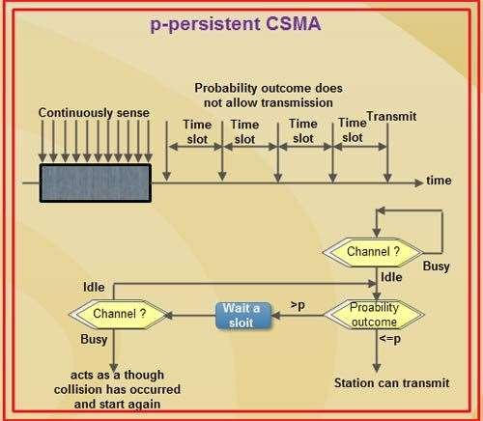
p-persistent CSMA

Slide 87
CSMA/CD
Carrier Sense Multiple Access with Collision Detection (CSMA/CD) is a network protocol for carrier transmission that operates in the Medium Access Control (MAC) layer.
It senses or listens whether the shared channel for transmission is busy or not, and defers transmissions until the channel is free.
The collision detection technology detects collisions by sensing transmissions from other stations.
On detection of a collision, the station stops transmitting, sends a jam signal, and then waits for a random time interval before retransmission.

Slide 88
CSMA/CD
The algorithm of CSMA/CD is:
When a frame is ready, the transmitting station checks whether the channel is idle or busy.
If the channel is busy, the station waits until the channel becomes idle.
If the channel is idle, the station starts transmitting and continually monitors the channel to detect collision.
If a collision is detected, the station starts the collision
resolution algorithm.
The station resets the retransmission counters and
completes frame transmission.

Slide 89
CSMA/CD
The algorithm of Collision Resolution is:
The station continues transmission of the current frame for a specified time along with a jam signal, to ensure that all the other stations detect collision.
The station increments the retransmission counter.
If the maximum number of retransmission attempts is reached, then the station aborts transmission.
Otherwise, the station waits for a backoff period which is generally a function of the number of collisions and restart main algorithm.

Slide 90
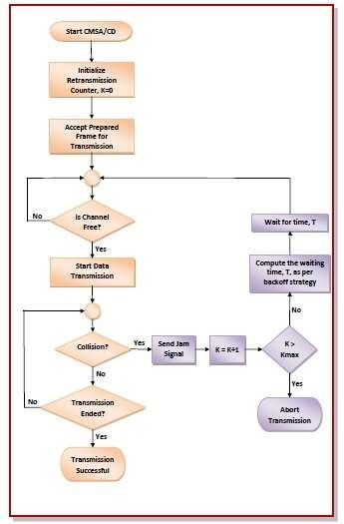
CSMA/CD

Slide 91
Collision-free protocols
In computer networks, when more than one station tries to transmit simultaneously via a shared channel, the transmitted data is garbled. This event is called collision.
The Medium Access Control (MAC) layer of the OSI model is responsible for handling collision of frames.
Collision – free protocols are devised so that collisions do not occur.
Protocols like CSMA/CD and CSMA/CA nullifies the possibility of collisions once the transmission channel is acquired by any station.
However, collision can still occur during the contention period if more than one stations starts to transmit at the same time. Collision – free protocols resolves collision in the contention period and so the possibilities of collisions are eliminated.

Slide 92
Collision-free protocols
Types of collision-free protocols
1.Bit-map protocol 2.Token passing 3.Binary countdown

Slide 93
Bit-map protocol
In this collision-free protocol, the basic bit-map method, each contention period consists of exactly N slots.
If station 0 has a frame to send, it transmits a 1 bit during the zeroth slot. No other station is allowed to transmit during this slot.
Regardless of what station 0 does, station 1 gets the opportunity to transmit a 1 during slot 1, but only if it has a frame queued.
In general, station j may announce that it has a frame to send by inserting a 1 bit into slot j. After all N slots have passed by, each station has complete knowledge of which stations wish to transmit. At that point, they begin transmitting in numerical order.

Slide 94

Bit-map protocol

Slide 95
Bit-map protocol
Since everyone agrees on who goes next, there will never be any collisions.
After the last ready station has transmitted its frame, an event all stations can easily monitor, another N bit contention period is begun.
If a station becomes ready just after its bit slot has passed by, it is out of luck and must remain silent until every station has had a chance and the bit map has come around again.
Protocols like this in which the desire to transmit is broadcast before the actual transmission are called reservation protocols.

Slide 96
Token Passing
A token is a small message that circulates among the stations of a computer network providing permission to the stations for transmission.
If a station has a frame to transmit when it receives a token, it sends the frame and then passes the token to the next station; otherwise it simply passes the token to the next station.
For token passing mechanism to operate, the stations should be connected in a single ring as shown in the following diagram

Slide 97
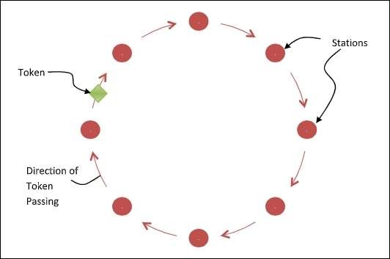
Token Passing

Slide 98
Token Passing
In the above configuration, passing the token comprise of receiving the token from the preceding station and transmitting to the successor station.
The data flow is unidirectional in the direction of the token passing. The token may be generated by the station that wants to send the frame or the station that wants to receive the frame.
In order that tokens are not circulated infinitely, they are
removed from the network once their purpose is completed.
Performance Analysis
The performance is similar to conventional bit map protocol. If N number of stations are in the token ring, the waiting time of each station is (N – 1). The advantage of this protocol over bit map protocol is that all the stations have equal priority for transmission.

Slide 99
Binary Countdown
A problem with the basic bit-map protocol is that the overhead is 1 bit per
station, so it does not scale well to networks with thousands of stations.
We can do better than that by using binary station addresses. A station wanting to use the channel now broadcasts its address as a binary bit string, starting with the high-order bit.
All addresses are assumed to be the same length. The bits in each address
position from different stations are BOOLEAN ORed together.
We will call this protocol binary countdown. It implicitly assumes that the transmission delays are negligible so that all stations see asserted bits essentially instantaneously.
To avoid conflicts, an arbitration rule must be applied: as soon as a station sees that a high-order bit position that is 0 in its address has been overwritten with a 1.

Slide 100
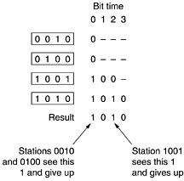
Binary Countdown

Slide 101
Wired LANs: Ethernet

Slide 102











































1.1 IEEE STANDARDS
In 1985, the Computer Society of the IEEE started a project, called Project 802, to set standards to enable intercommunication among equipment from a variety of manufacturers. Project 802 is a way of specifying functions of the physical layer and the data link layer of major LAN protocols.

Slide 103
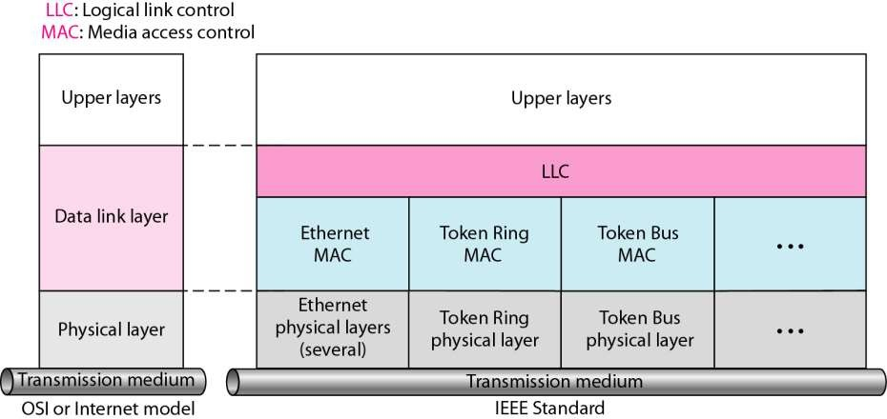
Figure 1.1 IEEE standard for LANs

Slide 104
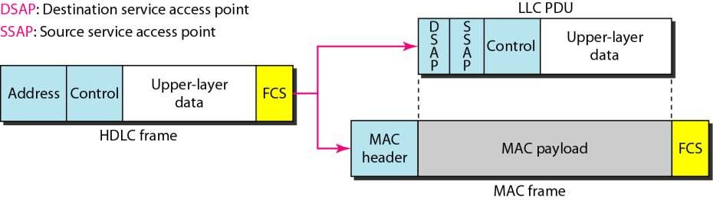
Figure 1.2 HDLC frame compared with LLC and MAC frames

Slide 105



































The original Ethernet was created in 1976 at Xerox’s Palo Alto Research Center (PARC). Since then, it has gone through four generations. We briefly discuss the Standard (or traditional) Ethernet in this section.
1.2 STANDARD ETHERNET

Slide 106
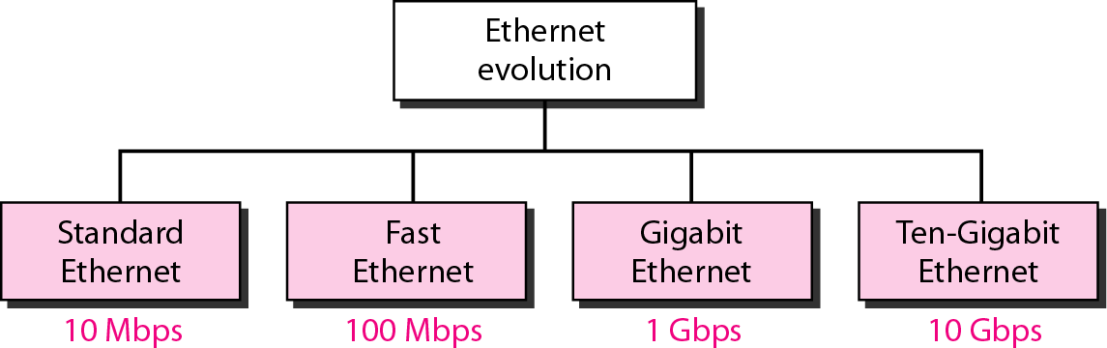
Figure 1.3 Ethernet evolution through four generations

Slide 107
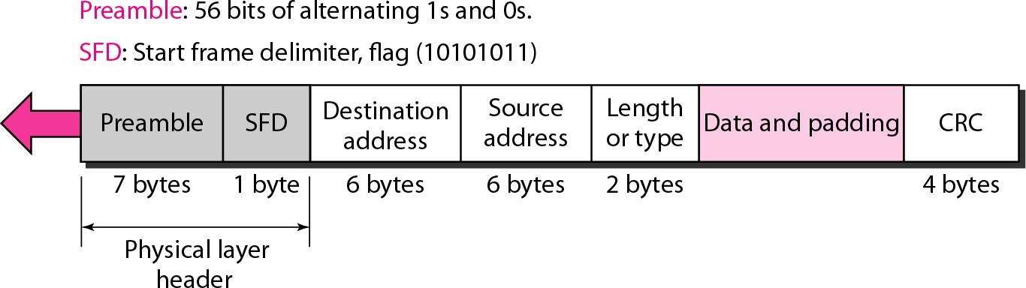
Figure 1.4 802.3 MAC frame

Slide 108
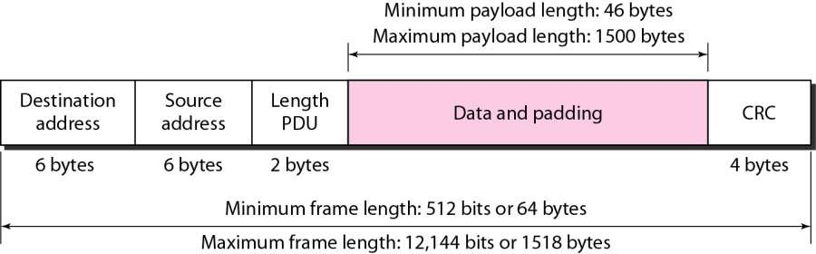
Figure 1.5 Minimum and maximum lengths

Slide 109




Note
Frame length: Minimum: 64 bytes (512 bits)
Maximum: 1518 bytes (12,144 bits)

Slide 110
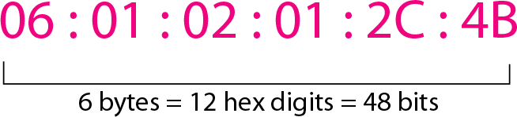
Figure 1.6 Example of an Ethernet address in hexadecimal notation

Slide 111
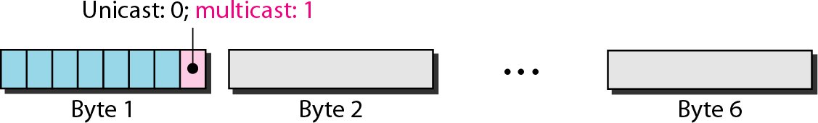
Figure 1.7 Unicast and multicast addresses

Slide 112
Note
The least significant bit of the first byte defines the type of address.
If the bit is 0, the address is unicast; otherwise, it is multicast.

Slide 113
Note
The broadcast destination address is a special case of the multicast address in which all bits are 1s.

Slide 114
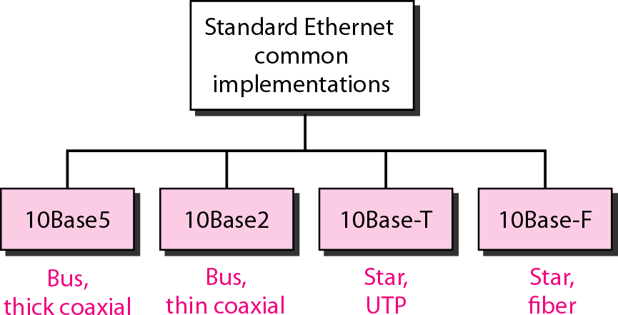
Figure 1.8 Categories of Standard Ethernet

Slide 115
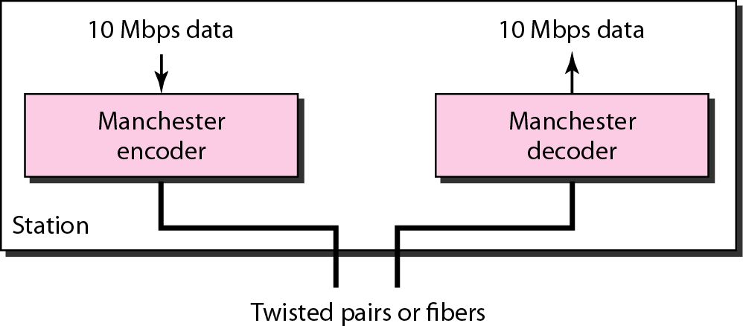
Figure 1.9 Encoding in a Standard Ethernet implementation

Slide 116
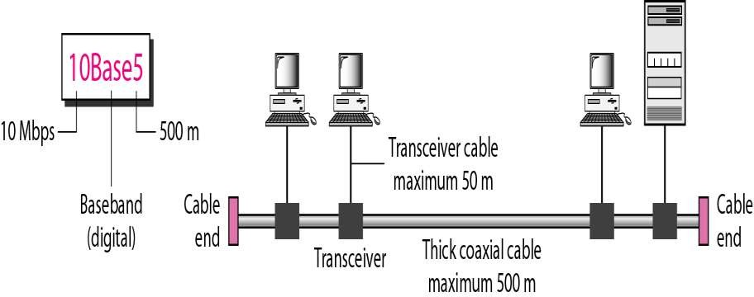
Figure 1.10 10Base5 implementation

Slide 117
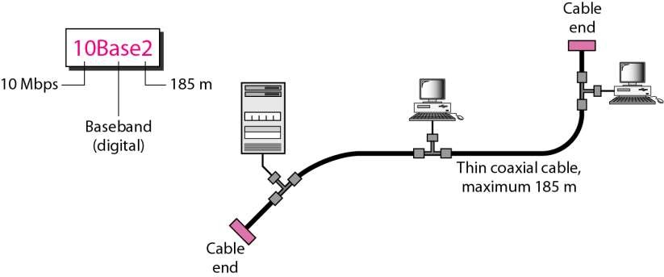
Figure 1.11 10Base2 implementation

Slide 118
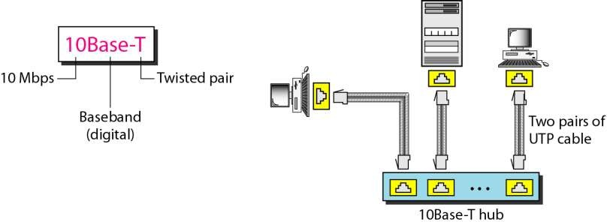
Figure 1.12 10Base-T implementation

Slide 119
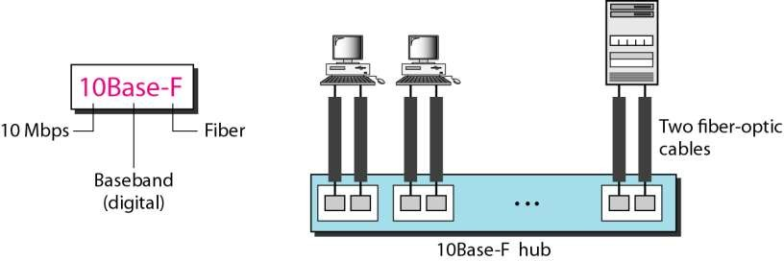
Figure 1.13 10Base-F implementation

Slide 120
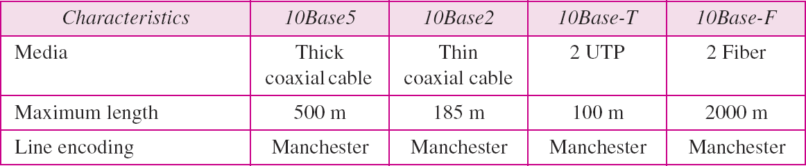
Table 1.1 Summary of Standard Ethernet implementations

Slide 121










































The 10-Mbps Standard Ethernet has gone through several changes before moving to the higher data rates. These changes actually opened the road to the evolution of the Ethernet to become compatible with other high- data-rate LANs.
1-3 CHANGES IN THE STANDARD

Slide 122
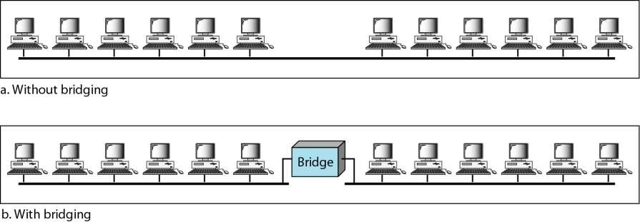
Figure 1.15 A network with and without a bridge

Slide 123

Figure 1.16 Collision domains in an unbridged network and a bridged network

Slide 124

Figure 1.17 Switched Ethernet

Slide 125

Figure 1.18 Full-duplex switched Ethernet

Slide 126










































Fast Ethernet was designed to compete with LAN
1.4 FAST ETHERNET
protocols such as FDDI or Fiber Channel. IEEE created Fast Ethernet under the name 802.3u. Fast Ethernet is backward-compatible with Standard Ethernet, but it can transmit data 10 times faster at a rate of 100 Mbps.

Slide 127

Figure 1.19 Fast Ethernet topology

Slide 128

Figure 1.20 Fast Ethernet implementations

Slide 129

Figure 1.21 Encoding for Fast Ethernet implementation

Slide 130

Table 1.2 Summary of Fast Ethernet implementations

Slide 131






























The need for an even higher data rate resulted in the design of the Gigabit Ethernet protocol (1000 Mbps). The IEEE committee calls the standard 802.3z.
1.5 GIGABIT ETHERNET
In the full-duplex mode of Gigabit Ethernet, there is no collision; the maximum length of the cable is determined by the signal attenuation in the cable.

Slide 132

Figure 1.22 Topologies of Gigabit Ethernet

Slide 133

Figure 1.23 Gigabit Ethernet implementations

Slide 134

Figure 1.24 Encoding in Gigabit Ethernet implementations

Slide 135

Table 1.3 Summary of Gigabit Ethernet implementations

Slide 136

Table 1.4 Summary of Ten-Gigabit Ethernet implementations

Slide 137
Wireless LANs
802.11 architecture and protocol stack
802.11 physical layer
802.11 MAC sublayer protocol
802.11 frame structure
Services

Slide 138

802.11 Architecture and Protocol Stack (1)
To Network
Access Point
Client
802.11 architecture – infrastructure mode

Slide 139

802.11 Architecture and Protocol Stack (2)
802.11 architecture – ad-hoc mode

Slide 140

802.11 Architecture and Protocol Stack (3)
Part of the 802.11 protocol stack.

Slide 141

The 802.11 MAC Sublayer Protocol (1)
Sending a frame with CSMA/CA.

Slide 142

The 802.11 MAC Sublayer Protocol (2)
The hidden terminal problem.

Slide 143

The 802.11 MAC Sublayer Protocol (3)
The exposed terminal problem.

Slide 144

The 802.11 MAC Sublayer Protocol (4)
The use of virtual channel sensing using CSMA/CA.

Slide 145

The 802.11 MAC Sublayer Protocol (5)
Interframe spacing in 802.11

Slide 146

802.11 Frame Structure
Format of the 802.11 data frame

Slide 147
Bluetooth
Bluetooth is, with the infrared, one of the major wireless technologies developed to achieve WPAN.
Bluetooth is a wireless LAN technology used to connect devices of different functions such as telephones, computers (laptop or desktop), notebooks, cameras, printers and so on. Bluetooth is an example of personal area network.
Bluetooth project was started by SIG (Special Interest Group) formed by four companies IBM, Intel, Nokia and Toshiba for interconnecting computing and communicating devices using short-range, lower-power, inexpensive wireless radios.
• The project was named Bluetooth after the name of Viking king – Harald Blaat and who unified Denmark and Norway in 10th century.

Slide 148
Bluetooth Architecture
Bluetooth architecture defines two types of networks:
Piconet
Scatternet
1. Piconet
• Piconet is a Bluetooth network that consists of one primary (master) node and seven active secondary (slave) nodes.
• Thus, piconet can have up to eight active nodes (1 master and 7 slaves) or stations within the distance of 10 meters.
• There can be only one primary or master station in each piconet.
• The communication between the primary and the secondary can be one-to-one or one-to-many.

Slide 149

Bluetooth Architecture
All communication is between master and a slave. Salve-slave communication is not possible.
In addition to seven active slave station, a piconet can have up to 255 parked nodes. These parked nodes are secondary or slave stations and cannot take part in communication until it is moved from parked state to active state.

Slide 150
Bluetooth Architecture
2. Scatternet
Scattemet is formed by combining various piconets.
A slave in one piconet can act as a master or primary in other piconet.
Such a station or node can receive messages from the master in the first piconet and deliver the message to its slaves in other piconet where it is acting as master. This node is also called bridge slave.
Thus a station can be a member of two piconets.
A station cannot be a master in two piconets.

Slide 151

Bluetooth Architecture

Slide 152

Bluetooth layers and Protocol Stack
Bluetooth standard has many protocols that are organized into different layers.
The layer structure of Bluetooth does not follow OS1 model, TCP/IP model or any other known model.
The different layers and Bluetooth protocol architecture.

Slide 153
Bluetooth layers and Protocol Stack
Radio Layer
The Bluetooth radio layer corresponds to the physical layer of OSI model.
It deals with ratio transmission and modulation.
The radio layer moves data from master to slave or vice versa.
It is a low power system that uses 2.4 GHz ISM band in a range of 10 meters.
This band is divided into 79 channels of 1MHz each. Bluetooth uses the Frequency Hopping Spread Spectrum (FHSS) method in the physical layer to avoid interference from other devices or networks.
Bluetooth hops 1600 times per second, i.e. each device changes its modulation frequency 1600 times per second.
In order to change bits into a signal, it uses a version of FSK called GFSK i.e. FSK with Gaussian bandwidth filtering.

Slide 154
Bluetooth layers and Protocol Stack
Baseband Layer
Baseband layer is equivalent to the MAC sub layer in LANs.
Bluetooth uses a form of TDMA called TDD-TDMA (time division duplex TDMA).
Master and slave stations communicate with each other using time slots.
The master in each piconet defines the time slot of 625 µsec.
In TDD- TDMA, communication is half duplex in which receiver can send and receive data but not at the same time.
If the piconet has only no slave; the master uses even numbered slots (0, 2, 4, …) and the slave uses odd-numbered slots (1, 3, 5, …. ). Both master and slave communicate in half duplex mode. In slot 0, master sends & secondary receives; in slot 1, secondary sends and primary receives.

Slide 155
Bluetooth layers and Protocol Stack
If piconet has more than one slave, the master uses even numbered slots. The slave sends in the next odd-numbered slot if the packet in the previous slot was addressed to it.
In Base-band layer, two types of links can be created between a master and slave. These are:
1. Asynchronous Connection-less (ACL)
It is used for packet switched data that is available at irregular intervals.
ACL delivers traffic on a best effort basis. Frames can be lost & may have to be re-transmitted.
A slave can have only one ACL link to its master.
Thus ACL link is used where correct delivery is preferred over fast delivery.
The ACL can achieve a maximum data rate of 721 kbps by using one, three or more slots.

Slide 156
Bluetooth layers and Protocol Stack
2. Synchronous Connection Oriented (SCO)
sco is used for real time data such as sound. It is used where fast delivery is preferred over accurate delivery.
In an sco link, a physical link is created between the master and slave by reserving specific slots at regular intervals.
Damaged packet; are not re-transmitted over sco links.
A slave can have three sco links with the master and can send data at 64 Kbps.

Slide 157
Bluetooth layers and Protocol Stack
Logical Link, Control Adaptation Protocol Layer (L2CAP)
The logical unit link control adaptation protocol is equivalent to logical link control sub-layer of LAN.
The ACL link uses L2CAP for data exchange but sco channel does not use it.
The various function of L2CAP is:
1. Segmentation and reassembly
L2CAP receives the packets of up to 64 KB from upper layers and divides them into frames for transmission.
It adds extra information to define the location of frame in the original packet.
The L2CAP reassembles the frame into packets again at the destination.

Slide 158
Bluetooth layers and Protocol Stack
2. Multiplexing
L2CAP performs multiplexing at sender side and de-multiplexing at receiver side.
At the sender site, it accepts data from one of the upper layer protocols frames them and deliver them to the Base-band layer.
At the receiver site, it accepts a frame from the base-band layer, extracts the data, and delivers them to the appropriate protocol1ayer.
3. Quality of Service (QOS)
L2CAP handles quality of service requirements, both when links are established and during normal operation.
It also enables the devices to negotiate the maximum payload size during connection establishment.

Slide 159

Bluetooth Frame Format
The various fields of Bluetooth frame format are:

Slide 160
Bluetooth Frame Format
1. Access Code: It is 72 bit field that contains synchronization bits. It identifies the master.
2. Header: This is 54-bit field. It contain 18 bit pattern that is repeated for 3 time.
The header field contains following sub-fields:
(i) Address: This 3 bit field can define up to seven slaves (1 to 7). If the address is zero, it is used for broadcast communication from primary to all secondaries.
(ii)Type: This 4 bit field identifies the type of data coming from upper layers.
(iii) F: This flow bit is used for flow control. When set to 1, it means the device is unable to receive more frames.

Slide 161
Bluetooth Frame Format
(iv) A: This bit is used for acknowledgement.
(v) S: This bit contains a sequence number of the frame to detect re-transmission. As stop and wait protocol is used, one bit is sufficient.
(vi) Checksum: This 8 bit field contains checksum to detect errors in header.
3. Data: This field can be 0 to 2744 bits long. It contains data or control information coming from upper layers

